Slide 1
VPC Concepts

Slide 2
Agenda
VPC and Subnet.
Route tables.
Internet gateways.
Elastic network interfaces.
VPC endpoints.

Slide 3
Subnets
A Classless Inter-Domain Routing (CIDR) block,
10.0.0.0/16.
VPC's principal or primary CIDR block.
Classless inter-domain routing (CIDR).
Referred as a subnetwork or subnet.

Slide 4
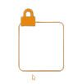
Subnets
Separating a network into two or more networks.
Two forms:
Public.
Private.
Allows the internet to access the machine.
Keeps the computer hidden from the internet.

Slide 5
Route Table
Set of rules called routes.
Where network traffic from our subnet or gateway goes.
A destination and a target are specified for each route.
Connect to the internet via an internet gateway.
Comes with our VPC by default.

Slide 6
Route Table
Any subnets that aren't expressly linked to another route table.
Where network traffic is directed in our VPC.
Each subnet in our VPC must have its route table.

Slide 7
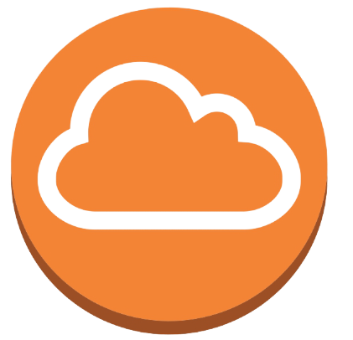
Internet Gateway
Connection between our VPC and the internet.
Scaled, redundant, and highly available.
Internet-routable traffic.
Network address translation (NAT).
Supported by an internet gateway.
In danger of being unavailable.
Comes at no extra cost.

Slide 8
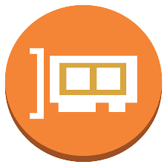
Network Interface
Represents a virtual network card.
Used for private use.
One Elastic IP address.
Default network interface with a private IPv4 address.

Slide 9

VPC Endpoints
Create private connections.
Enabled by AWS Private Link.
Allows us to use private IP addresses to access services discreetly.

Slide 10
VPC Endpoints
An internet gateway.
Virtual private gateway.
NAT device.
VPN connection.
AWS Direct Connect connection are not required for a VPC endpoint.

